Slide 1
Computer Organization and Assembly Fall 2019
Lecture 4
Syeda Farwa Batool

Slide 2
Addressing Mode
An addressing mode specifies how to calculate the effective memory address of an operand by using information held in registers and/or constants contained within a machine instruction or elsewhere.

Slide 3
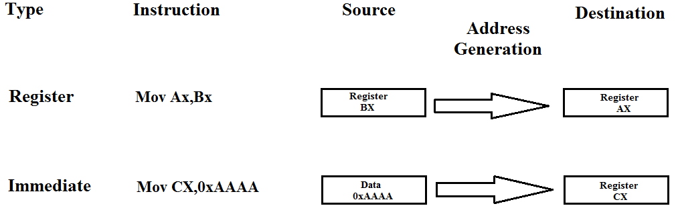
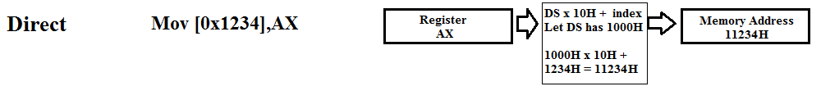
Addressing Modes

Slide 4
Direct Addressing
In direct addressing we can store and retrieve data from and to any location of memory.
Now our memory is stored in Data segment. So we can say that we can access any offset of Data Segment.
For now we can store data in
Bytes
Words
Double

Slide 5
Data Declaration
Declare Byte Syntax
db somevalue
Declare Word Syntax
dw somevalue
Declare Double Syntax
dd somevalue

Slide 6
Label
The leftmost field is called the label.
Used to store a symbolic name for the memory location it represents
All labels must not begin with a letter or one of the following special characters: @, $, -, or ?.
A label may any length from 1 to 35 characters
The label appears in a program to identify the name of a memory location for storing data and for other purposes.

Slide 7
Cont.
To refer to a variable later in the program, we need the address occupied
by this variable. The assembler is there to help us. We can associate a symbol with any address that we want to remember and use that symbol in the rest of the code.
myByteVar:
myWordVar:
myDoubleVar:
db somevalue
dw somevalue
dd somevalue

Slide 8
First Assembly Program Again with variables
; a program to add three numbers using memory variables
[org 0x0100]
mov ax, [num1] ; load first number in ax
mov bx, [num2] ; load second number in bx
add ax, bx ; accumulate sum in ax
mov bx, [num3] ; load third number in bx
add ax, bx ; accumulate sum in ax
mov [num4], ax ; store sum in num4
mov ax, 0x4c00 ; terminate program
int 0x21
num1: dw 5
num2: dw 10
num3: dw 15
num4: dw 0

Slide 9
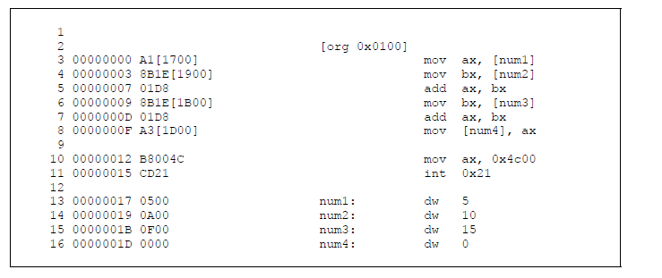
Listing file of new Code

Slide 10
Now we have all three number in an Array
; a program to add three numbers using memory variables
[org 0x0100]
mov ax, [num1] ; load first number in ax
mov bx, [num1 + 2] ; load second number in bx
add ax, bx ; accumulate sum in ax
mov bx, [num1 + 4] ; load third number in bx
add ax, bx ; accumulate sum in ax
mov [num1 + 6], ax ; store sum in num4
mov ax, 0x4c00 ; terminate program
int 0x21
num1: dw 5
dw 10
dw 15
dw 0

Slide 11
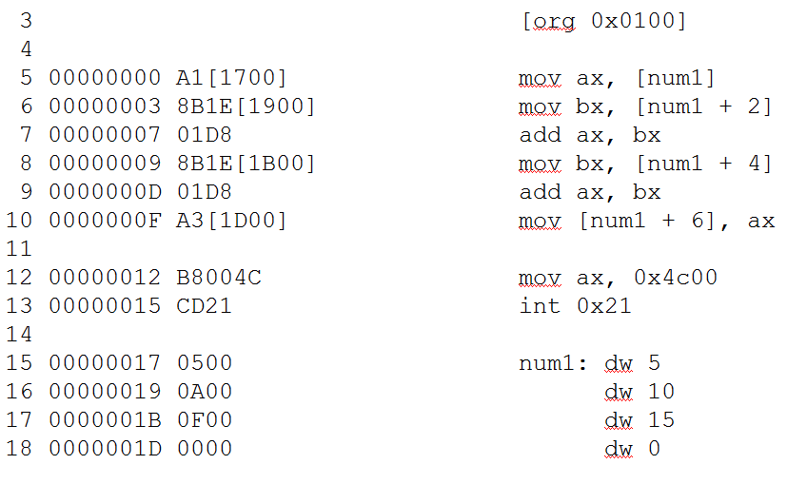
Listing file of new Code

Slide 12
Memory To Memory
Mov [num1] , [num2]
Mov [bx] , [num2]
Mov [bx+di] , [num2]
All memory to memory operations in one instruction are illegal

Slide 13
SIZE MISMATCH ERRORS
mov [num1], 5
mov byte [num1], 5
mov word [num1], 5
mov ax, [num1]
num1: db 5
mov al, [num1]
Syntax illegal
legal
Logically illegal
legal

Slide 14
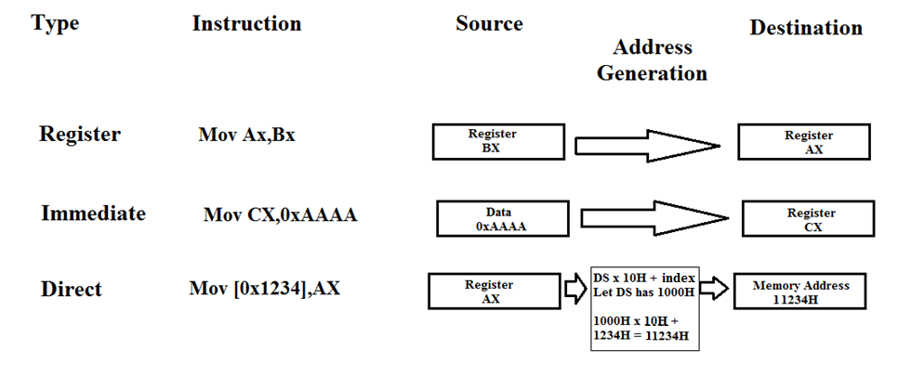
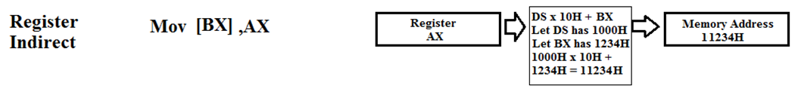
REGISTER INDIRECT ADDRESSING

Slide 15
Cont.
; a program to add three numbers using memory variables
[org 0x0100]
mov bx, num1 ; point bx to first number
mov ax, [bx] ; load first number in ax
add bx,2 ; advance bx to second number
add ax, [bx] ; add second number in ax
add bx,2 ; advance bx to third number
add ax, [bx] ; load third number in bx
add bx,2 ; advance bx to result
mov [bx], ax ; store sum in num4
mov ax, 0x4c00 ; terminate program
int 0x21
num1: dw 5, 10, 15, 0

Slide 16
Reg + offset
mov bx,num1
mov di, 0
mov ax, [bx + di]
add di, 2
add ax, [bx + di]
add di , 2
add ax, [bx + di]
add di , 2
mov [bx + di] , ax
num1: dw 10, 20, 30, 0

